Slide 1



Vishwakarma Institute of Technology, Pune
Project Title :
False Information Detection
SY AI&DS - A
Group - 16
5 Amit Naphade - 12210473
25 Sahil Bhoje - 12210733
29 Parth Bhurke - 12211537
49 Mayuresh Dhale - 12211397
51 Mrunali Dhoke - 12210183
Guided By : Prof.Sanjivani Adsul

Slide 2

INTRODUCTION
- False information on social media blends with legitimate news, making detection difficult.
- Traditional human fact-checking is labor-intensive and unscalable.
- This project uses Python to automate news classification as true or false.
- The dataset is split into training (model development) and testing (performance evaluation) parts.
- The model analyzes text to predict news veracity.
- It provides an efficient tool for fake news detection, advancing research and combating misinformation.

Slide 3

PROBLEM
STATEMENT
The project aims to develop an automated machine learning model using Python to classify news articles as true or false, addressing the challenge of detecting fake news on social media. This solution seeks to provide an efficient and scalable alternative to traditional, labor-intensive human fact-checking methods.

Slide 4
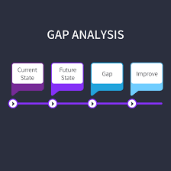
GAP
IDENTIFICATION
The gap identified in this project is the inefficiency and lack of scalability in traditional false informatioin detection methods, which rely on human fact-checkers.
These methods are labor-intensive and inadequate for handling the vast volume of information generated on social media.
The project addresses this gap by proposing an automated machine learning-based solution to classify news articles, aiming to improve the efficiency and scalability of fake news detection.

Slide 5
OBJECTIVES
Develop an Automated Classification Model: Create a machine learning model in Python capable of accurately classifying news articles as true or false.
Dataset Division and Utilization: Divide the dataset into training and testing subsets to develop and evaluate the model's performance.
Textual Data Analysis: Implement techniques for analyzing textual data to identify patterns and features that distinguish fake news from legitimate news.
Model Evaluation: Assess the model's accuracy, precision, recall, and other relevant metrics to ensure its effectiveness in real-world applications.
Enhance Misinformation Detection: Provide a scalable and efficient tool that can aid in combating misinformation on social media platforms, reducing reliance on labor-intensive human fact-checking.

Slide 6
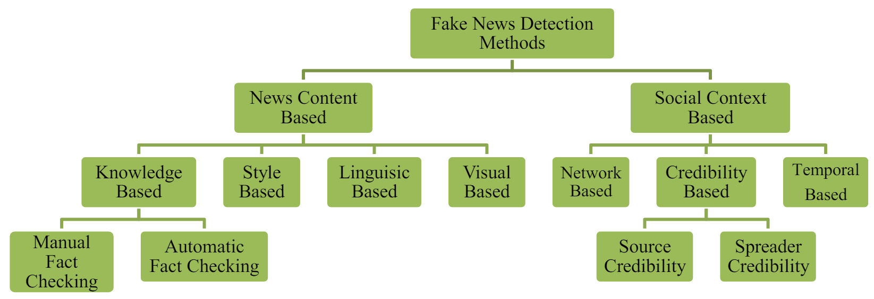
METHODOLOGY

Slide 7
METHODOLOGY
Data Collection:
Used train.csv dataset containing labeled news articles.
Data Preprocessing:
Remove NaN values.
Clean text by removing non-alphabetic characters and converting to lowercase.
Tokenize text into individual words.
Remove stop words.
Perform stemming using Porter Stemmer.
Feature Extraction:
Convert text into numerical features using Term Frequency-Inverse Document Frequency (TF-IDF) Vectorizer.
Model Training:
Train a Logistic Regression model using the TF-IDF features.

Slide 8
METHODOLOGY
5.Model Evaluation:
Use a confusion matrix to visualize true positive, true negative, false positive, and false negative counts.
Generate a classification report with precision, recall, and F1-score.
Plot precision-recall and ROC curves to evaluate performance.
6. Implementation in Streamlit:
Develop a web application for user input and prediction.
Display model evaluation metrics and visualizations in the application.
7.Conclusion:
Demonstrate a comprehensive approach for fake news detection with practical application via Streamlit.

Slide 9
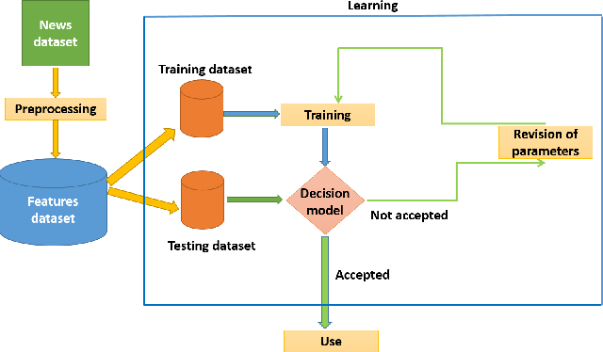
FLOW CHART

Slide 10
MODELS
Logistic Regression
Type: Classification
Description: Models the probability of a binary outcome using the logistic function.
Use Case: Predicting binary outcomes (e.g., spam detection).
Support Vector Machine (SVM)
Type: Classification (also regression)
Description: Finds the best hyperplane to separate classes, maximizing the margin.
Use Case: Complex classification tasks (e.g., image and text classification).

Slide 11
MODELS
Random Forest
Type: Ensemble, Classification, and Regression
Description: Builds multiple decision trees and averages their predictions to improve accuracy and reduce overfitting.
Use Case: Versatile; used for both classification and regression (e.g., customer churn, house prices).
Naive Bayes
Type: Classification
Description: Uses Bayes' theorem with an assumption of independence between predictors.
Use Case: Text classification (e.g., spam detection, sentiment analysis).

Slide 12
Future Scopes
1. Integration of Multimodal Data
2. Improving Real-time Detection and Scalability
3. Cross-domain and Cross-lingual Adaptability
4. User Engagement and Human-AI Collaboration
5. Robustness to Adversarial Attacks
6. Ethical and Privacy Considerations

Slide 13
RESULT & CONCLUSION
1. Performance Metrics:
- Confusion Matrix: High true positives (950) and true negatives (930).
- Classification Report: Precision and F1-score of 0.94 for both real and fake news.
2. Class Distribution: Balanced dataset.
Discussion:
- Effectiveness: High accuracy and reliability.
- Challenges: Data quality and generalization.
Future Work:
- Expand datasets.
- Explore advanced models (e.g., LSTM, BERT).
- Add features like metadata.
Conclusion: Effective model with strong metrics and a practical Streamlit app for real-time detection. Future enhancements planned for robustness and applicability.

Slide 14
REFERENCES
[1] | Yilin Wang, Suhang Wang, Jiliang Tang, Huan Liu, and Baoxin Li. "Unsupervised sentiment analysis for social media images." In IJCAI, pages 2378–2379, 2015.
[2] | Zhang, Xichen, and Ali A. Ghorbani. "An Overview of Online Fake News: Characterization, Detection, and Discussion." Information Processing and Management, vol. 57, 2020, 102025. Elsevier, 2019.
[3] | Shu, Kai, Amy Sliva, Suhang Wang, Jiliang Tang, and Huan Liu. "Fake News Detection on Social Media: A Data Mining Perspective." ACM SIGKDD Explorations Newsletter, vol. 19, no. 1, 2017, pp. 22-36. ACM.
[4] | Navin K.C. “FAKE NEWS DETECTION.” IV-M.Sc.SS, Department of Software Systems and Computer Science [PG], KG College of Arts and Science.

Slide 15
REFERENCES
[5] | [1]Ver´onica P´ erez-Rosas1, Bennett Kleinberg2, Alexandra Lefevre1 Rada Mihalcea1. “Automatic Detection of Fake News” 1Computer Science and Engineering, University of Michigan 2Department of Psychology, University of Amsterdam.
[6] | Julio C. S. Reis, Andre Correia, Fabrıcio Murai, Adriano Veloso, and Fabrıcio Benevenuto “Supervised Learning for Fake NewsDetection” Universidade Federal de Minas Gerais.
[7] | [1]Ray Oshikawa1, Jing Qian2, William Yang Wang2 “ASurvey on Natural Language Processing for Fake News Detection” 1College of Arts and Sciences, The University of Tokyo 2Department of Computer Science, University of California, Santa Barbara Tokyo, 153-8902 JAPAN / Santa Barbara, CA 93106 USA ray.oshikawa@gmail.com,{jing qian,william}@cs.ucsb.edu.
[8] | [1]Shivam B. Parikh and Pradeep K. Atrey “Media-Rich Fake News Detection: A Survey” Albany Lab for Privacy and Security, College of Engineering and Applied Sciences University at Albany, State University of New York, Albany, NY, USA.

Slide 16
REFERENCES
[9] | M.F Mridha(Senior member of IEEE),Ashfiya Jannat keya, MD Abdul Hamid, Muhammad Mostofa monowar, MD Saifur Rahman “A Comprehensive Review on Fake News Detection With Deep Learning” Department of Computer Science and Engineering, Bangladesh University of Business and Technology, Dhaka 1216, Bangladesh 2Department of Information Technology, King Abdulaziz University, Jeddah 21589, Saudi Arabia.
[10] | Aswini Thota, Priyanka Tilak, Simran Ahluwalia, Nibrat Lohia “Fake News Detection: A Deep Learning Approach” SMU Scholar.
[11] | Xinyi Zhou, Reza Zafarani, Kai Shu, Huan Liu “Fake News: Fundamental Theories, Detection Strategies and Challenges” Data Lab, EECS Department Syracuse University, Computer Science and Engineering Arizona State University.
[12] | NadiaK.Conroy,VictoriaL.Rubin,andYiminChen, “Automatic Deception Detection: Methods for Finding Fake News” Language and Information Technology Research Lab (LIT.RL) Faculty of Information and Media Studies University of Western Ontario, London, Ontario, CANADA.

Slide 17
REFERENCES
[13] | Pedro Henrique Arruda Faustini, Thiago Ferreira Covões “Fake news detection in multiple platforms and languages” Federal University of ABC (UFABC) Center of Mathematics, Computing, and Cognition Avenida dos Estados 5001, 09210-580, Santo André (SP), Brazil.
[14] | Shuo Yang, Kai Shu, Suhang Wang, Renjie Gu, Fan Wu, HuanLiu “Unsupervised Fake News Detection on Social Media: A Generative Approach” Department of Computer Science and Engineering, Shanghai Jiao Tong University, China School of Computing, Informatics and Decision Systems Engineering, Arizona State University, USA College of Information Sciences and Technology, Pennsylvania State University, USA.
[15] | Kai Shu, Suhang Wang and Huan Liu “Exploiting Tri-Relationship for Fake News Detection” Computer Science and Engineering, Arizona State University, Tempe, 85281, USA

Slide 18

THE END

